Slide 1
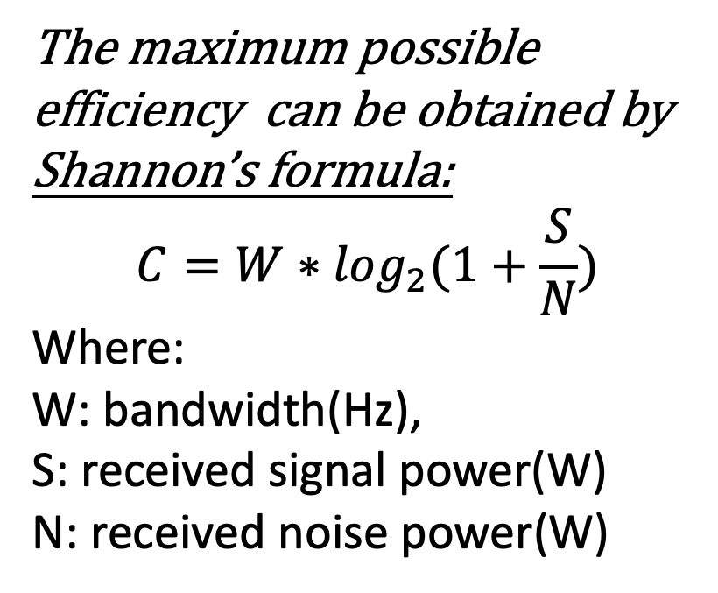
Area Spectral Efficiency of Cellular Mobile Radio Systems
What is Spectral Efficiency?
Spectral efficiency refers to the information rate (bits/s) that can be transmitted over a given bandwidth (Hz) in a specific communication system
The maximum possible efficiency can be obtained by Shannon’s formula:
$$C=W∗\log_{2}(1+\frac{S}{N})$$
Where:
W: bandwidth(Hz),
S: received signal power(W)
N: received noise power(W)

Slide 2
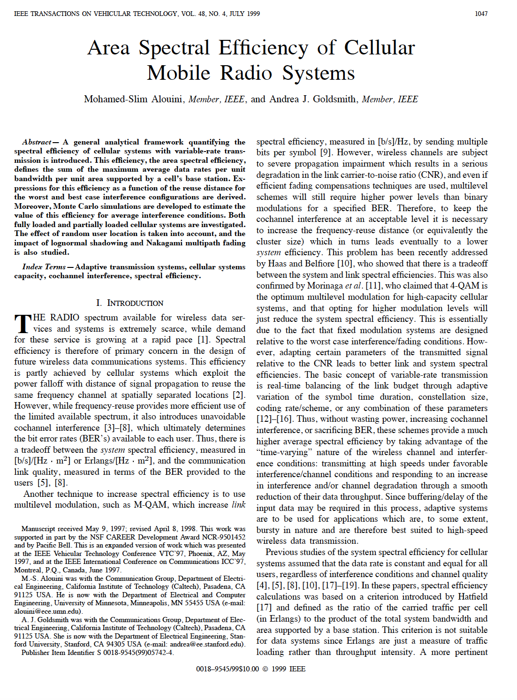

Slide 3
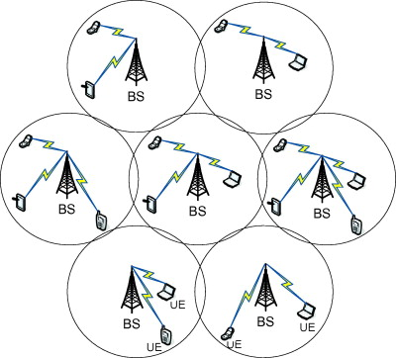
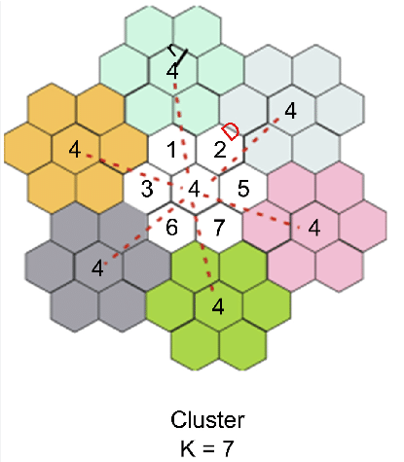
Cellular model
Area Spectral Efficiency of Cellular Mobile Radio Systems
What is Cellular Mobile Radio Systems?
Area Spectral Efficiency(ASE) :
-The maximum average data rates per unit bandwidth per unit area([bits/s]/[Hz*m2])

Slide 4
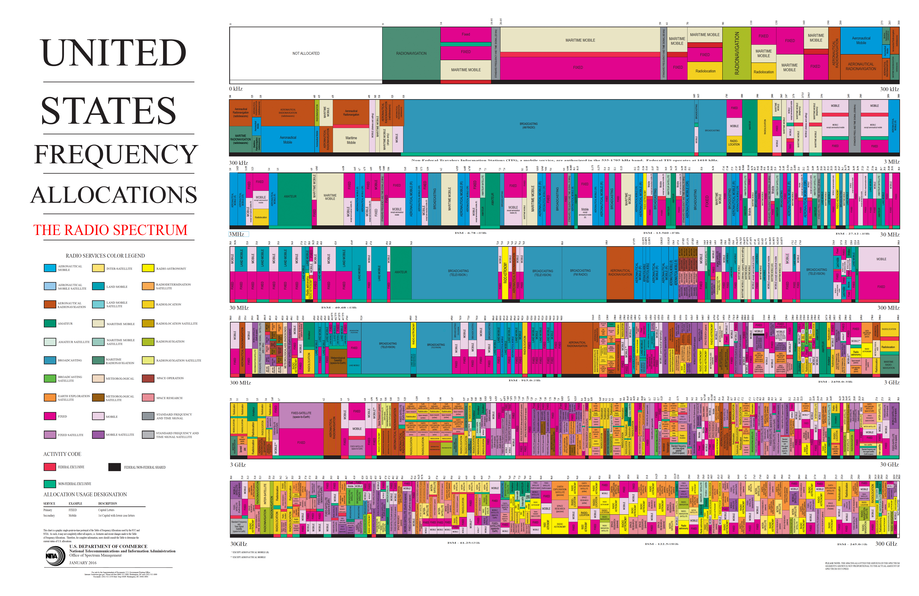
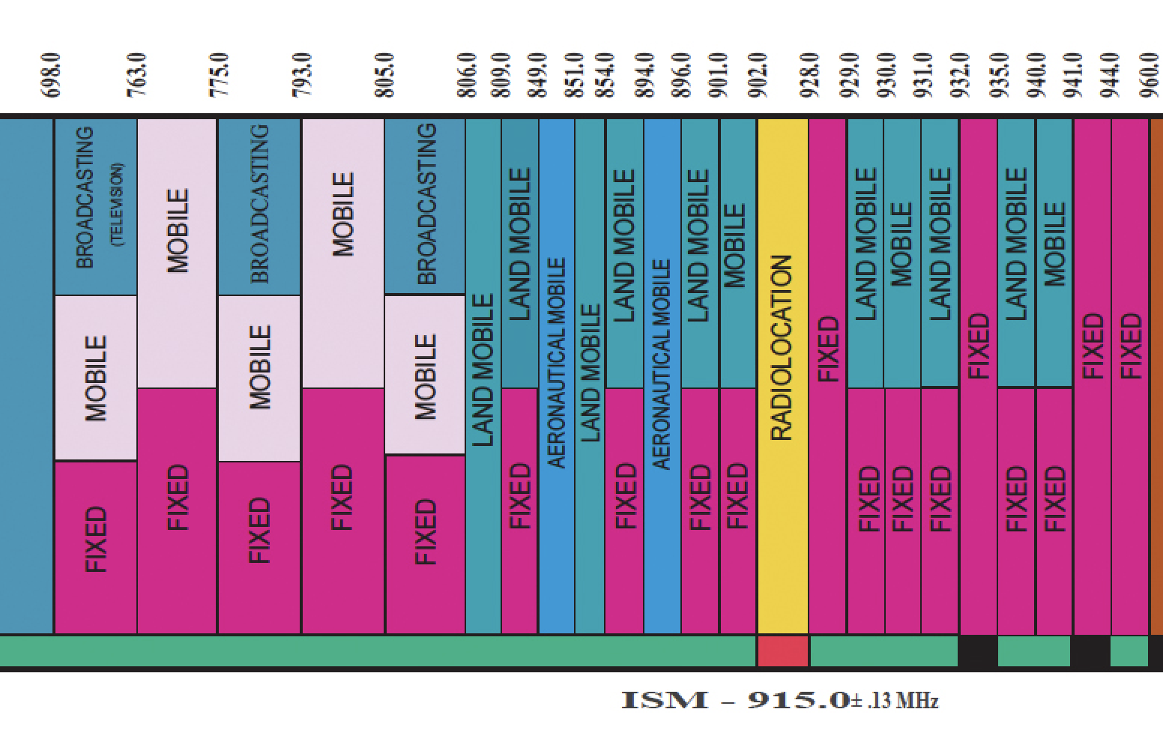
Area Spectral Efficiency of Cellular Mobile Radio Systems
Why this topic is important?
Because spectrum is a precious resources!

Slide 5
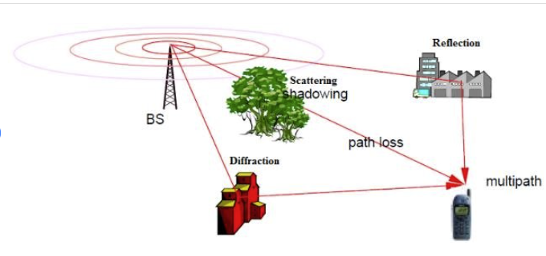
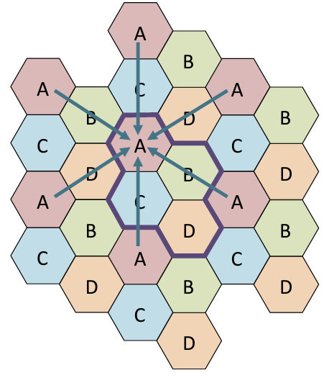
Four main factors affect Area Spectral Efficiency (ASE)
Path loss
Shadowing
Multipath
Cochannel interference

Slide 6
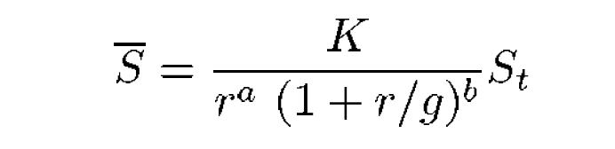
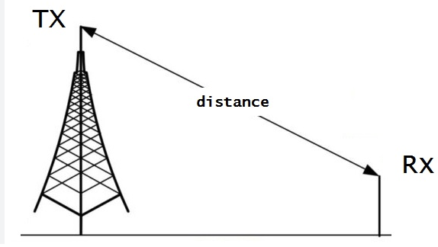
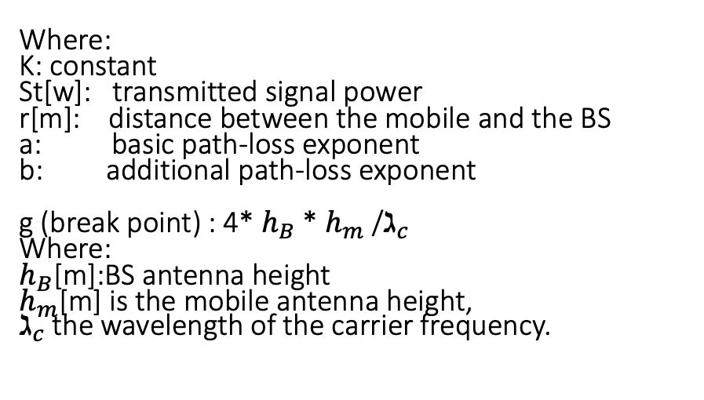
Four main factors affect Area Spectral Efficiency (ASE)
(1) Path loss
Where:
K: constant
St[w]: transmitted signal power
r[m]: distance between the mobile and the BS
a: basic path-loss exponent
b: additional path-loss exponent
g (break point) : 4* $h_{B}$* $h_{m}$/$ℷ_{c}$
Where:
$h_{B}\text{[}\text{m}\text{]}$:BS antenna height
$h_{m}$[m] is the mobile antenna height,
$ℷ_{c}$the wavelength of the carrier frequency.

Slide 7
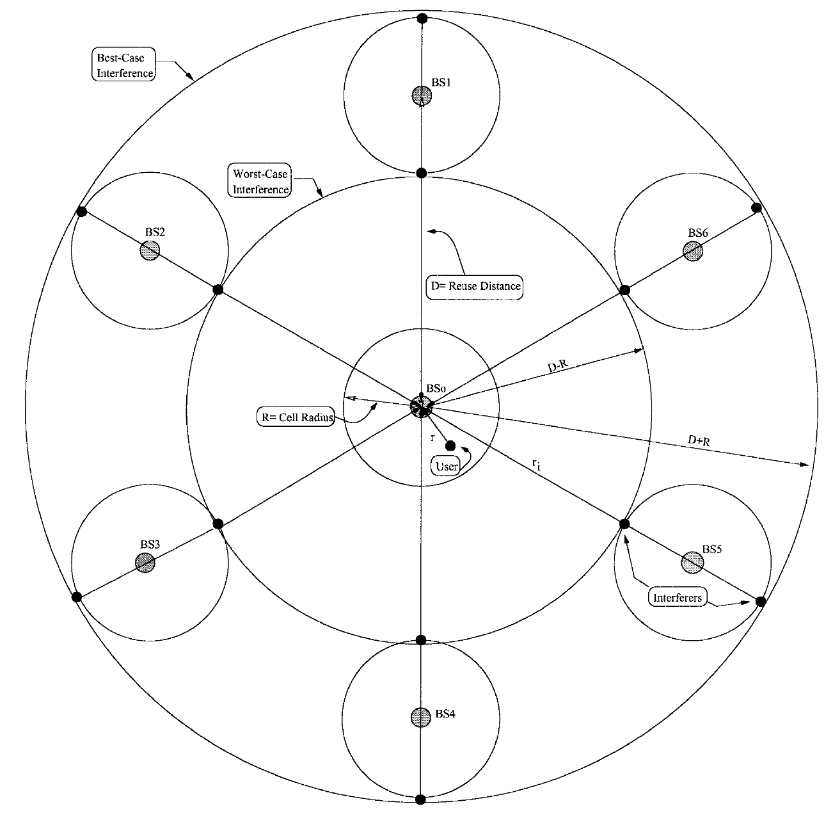
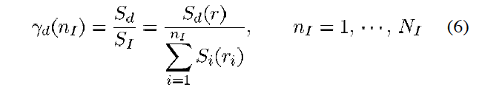

Four main factors affect Area Spectral Efficiency (ASE)
(1) Path loss
$$C=W∗\log_{2}(1+\frac{S}{N})$$

Slide 8
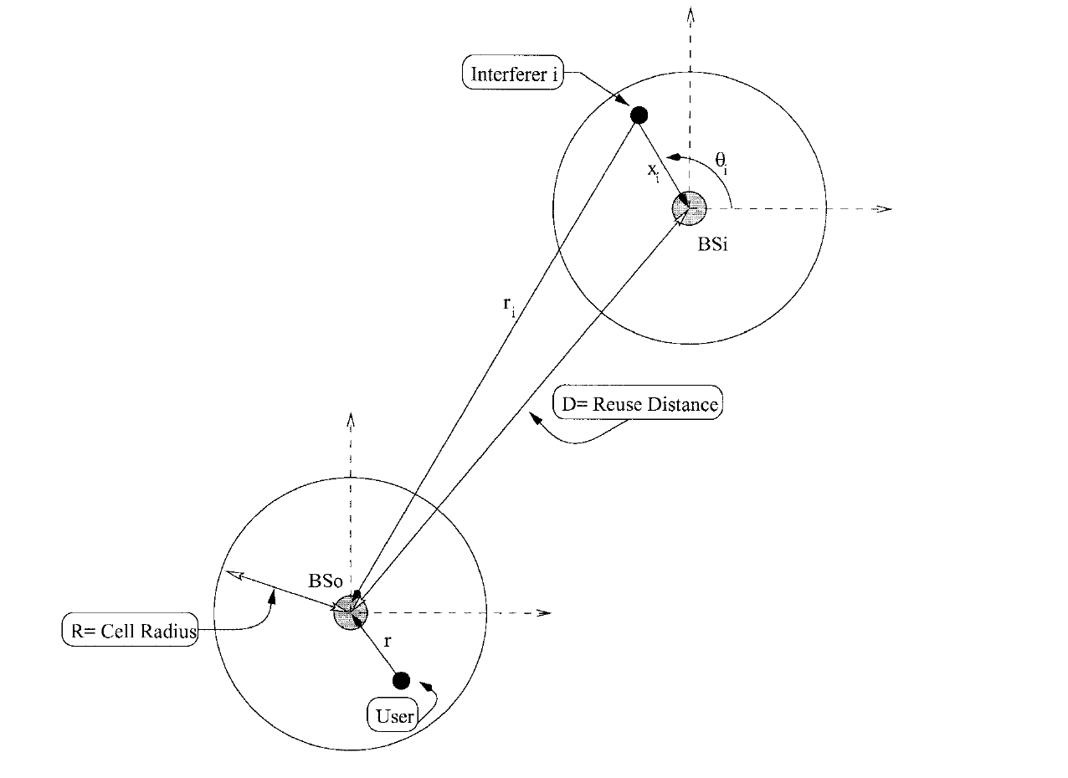
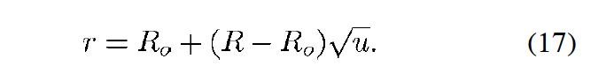
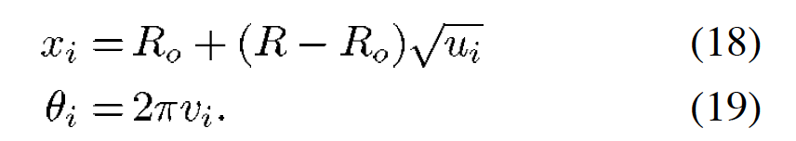
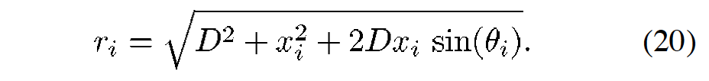
Four main factors affect Area Spectral Efficiency (ASE)
(1) Path loss
Monte Carlo simulation:
The underlying concept is to use randomness to solve problems that might be deterministic in principle
u =rand(1,1);
ui=rand(6,1);
vi=rand(6,1);
xi=R0+(R-R0)*(ui.^(1/2));
thetai=2*pi*vi;
ri=(D*D+(xi).^2+(2*D*xi).*sin(thetai)).^(1/2);

Slide 9
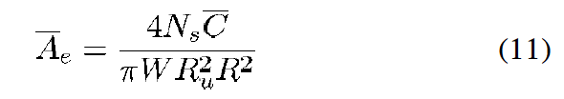
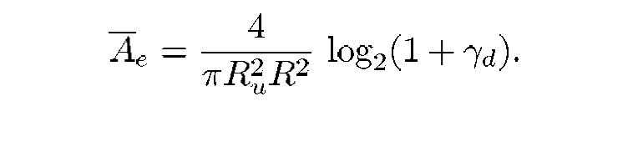

Four main factors affect Area Spectral Efficiency (ASE)
(1) Path loss
$$C=W∗\log_{2}(1+\frac{S}{N})$$

Slide 10
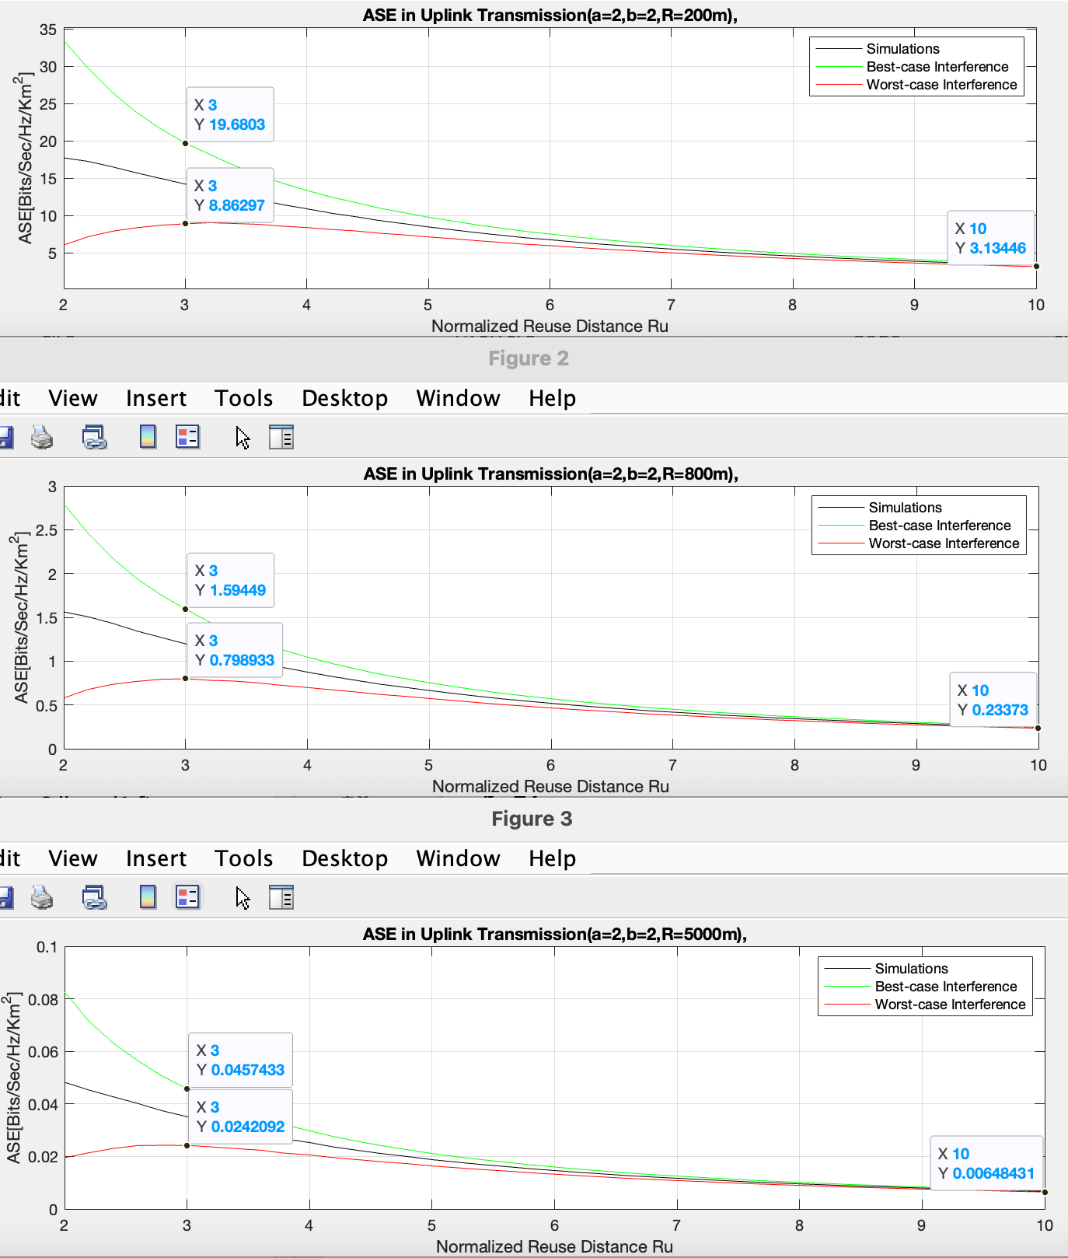
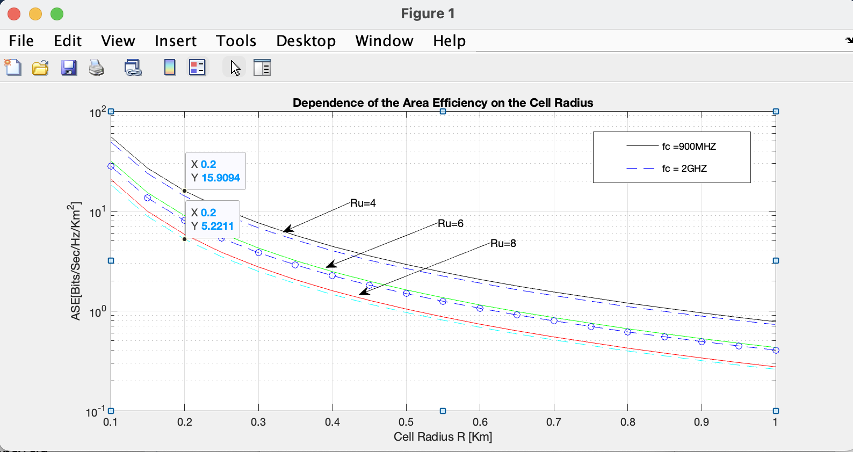
Four main factors affect Area Spectral Efficiency (ASE)
(1) Path loss

Slide 11
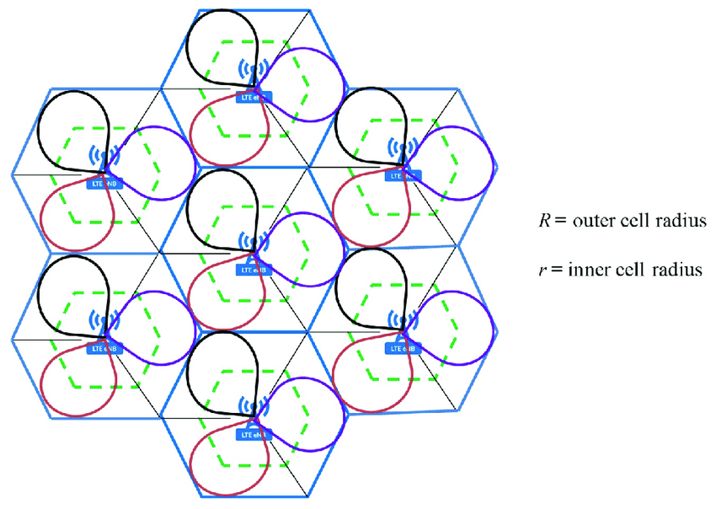
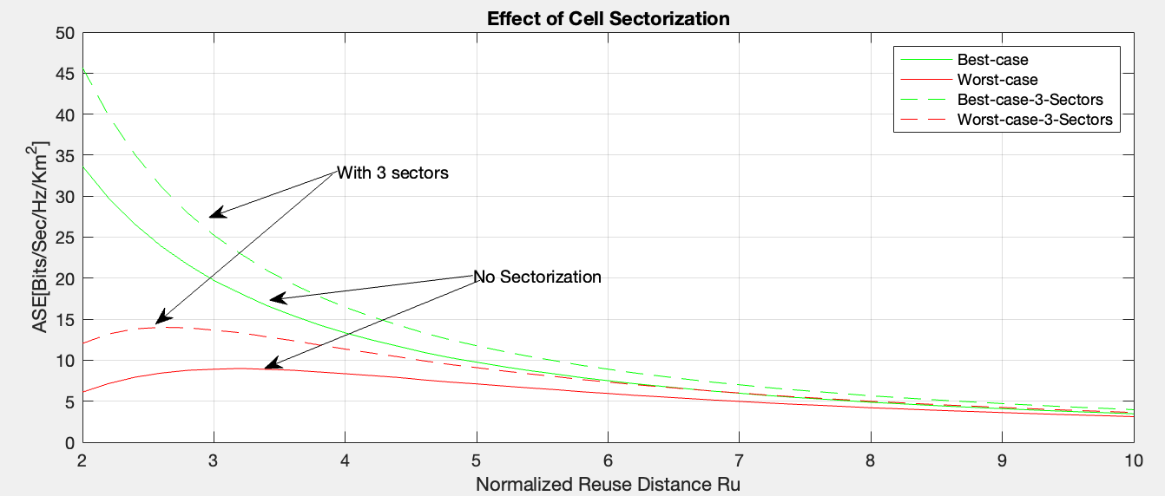
Four main factors affect Area Spectral Efficiency (ASE)
(1) Path loss

Slide 12
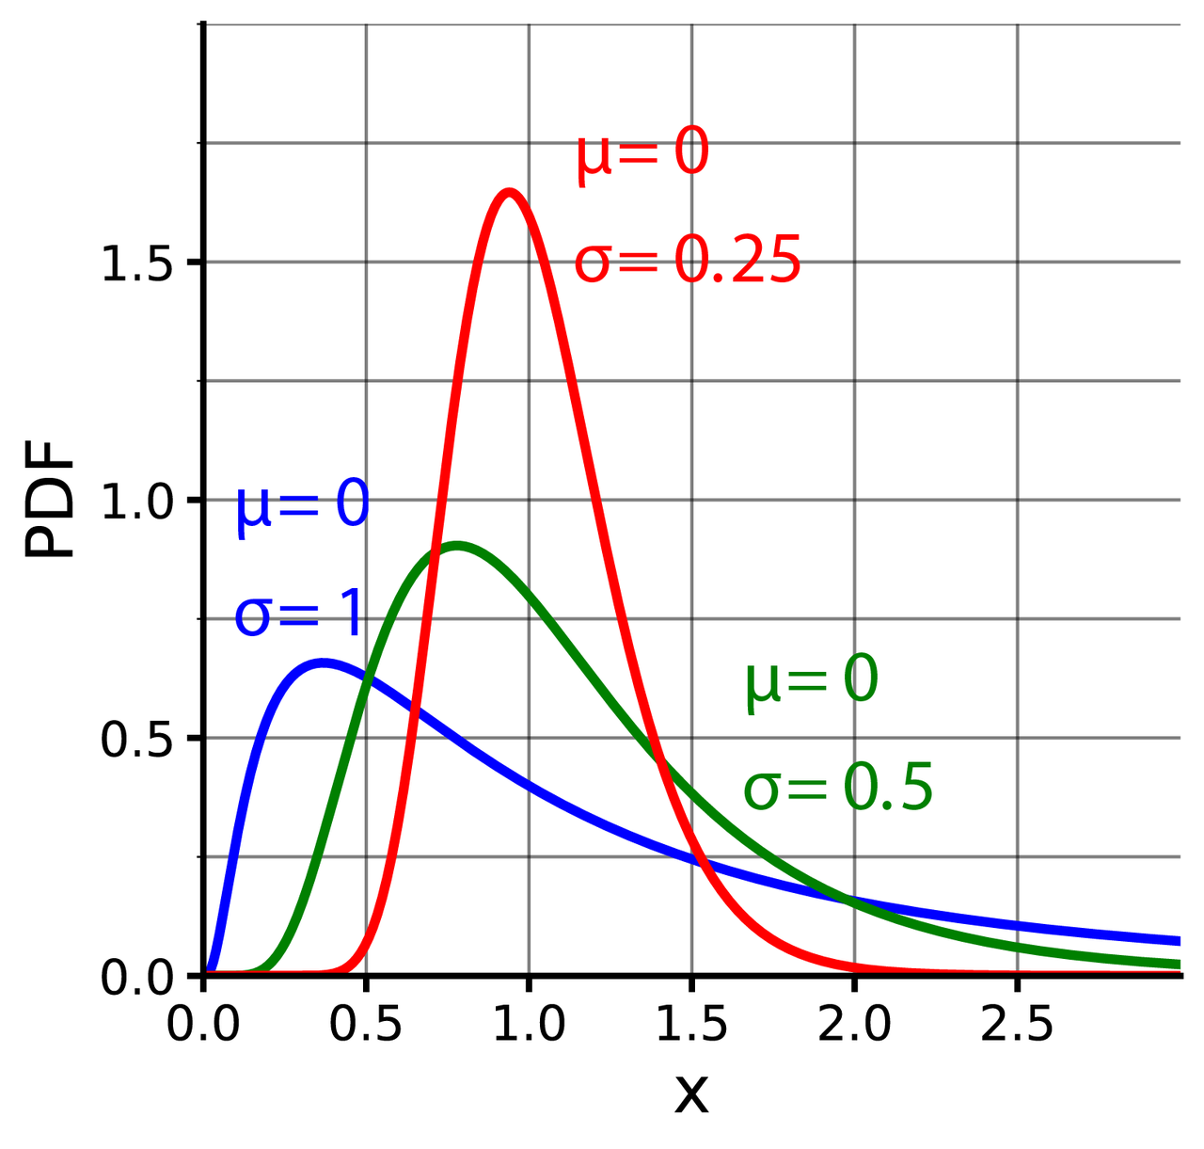
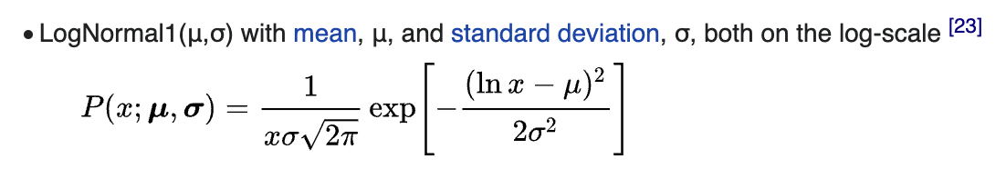
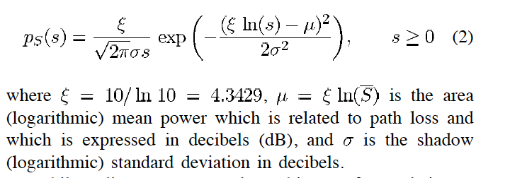
Four main factors affect Area Spectral Efficiency (ASE)
(2) Shadowing

Slide 13
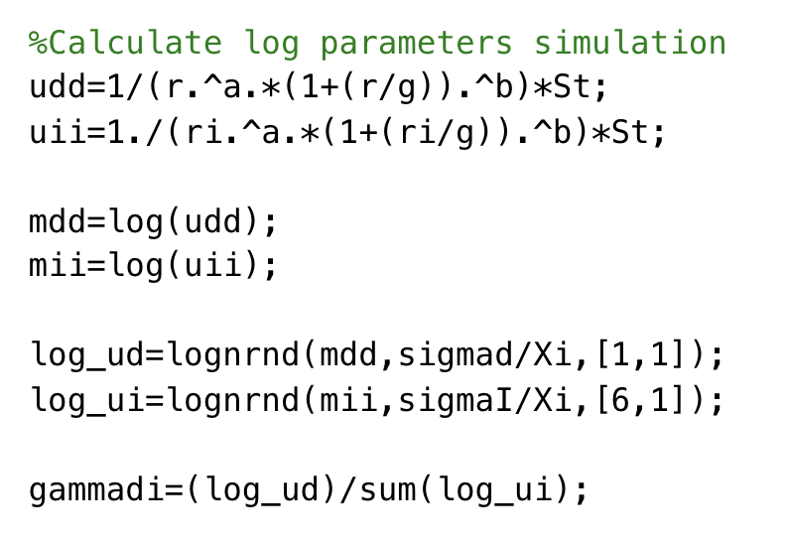
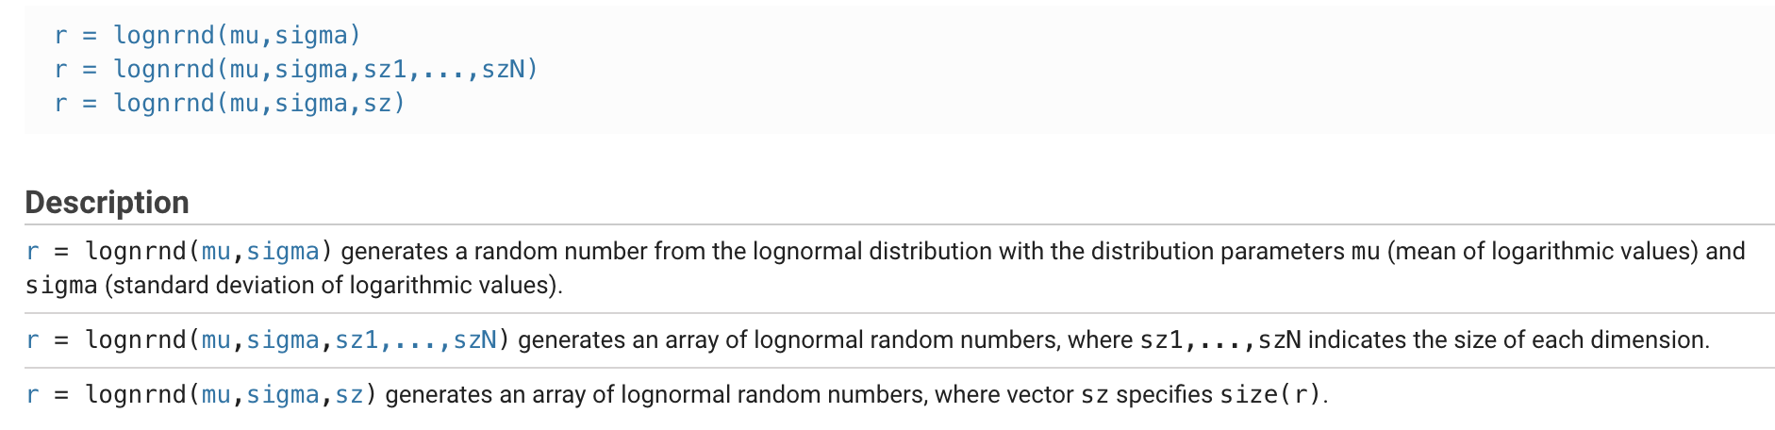
Four main factors affect Area Spectral Efficiency (ASE)
(2) Shadowing

Slide 14
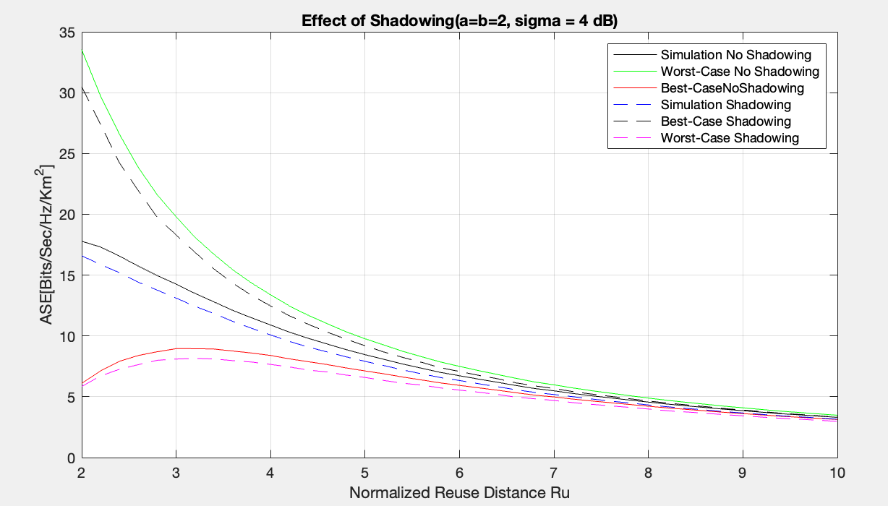
Four main factors affect Area Spectral Efficiency (ASE)
(2) Shadowing

Slide 15
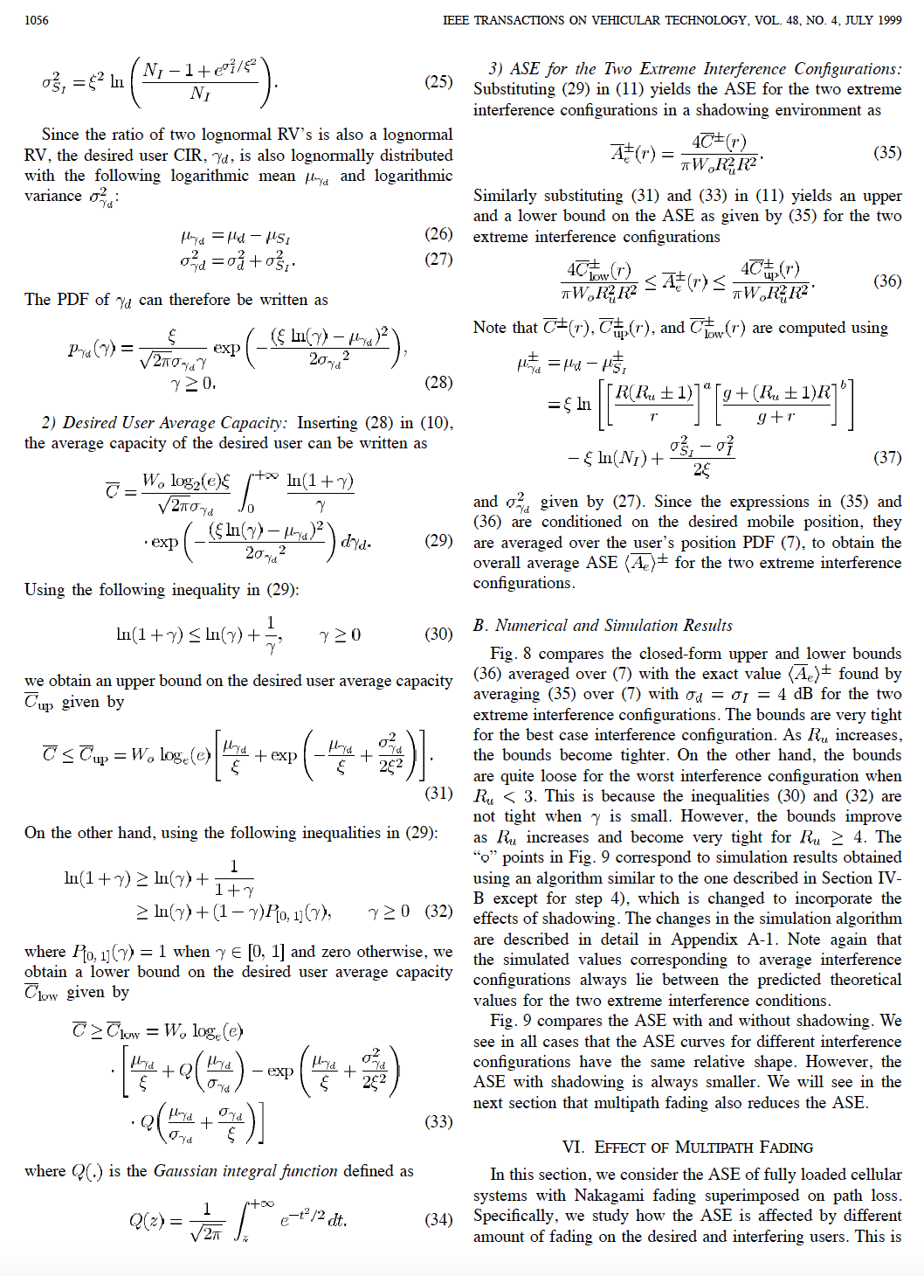
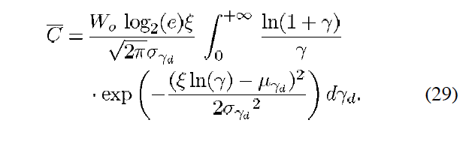
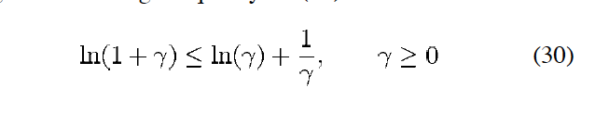
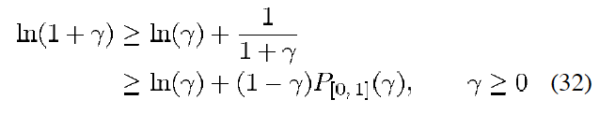
Four main factors affect Area Spectral Efficiency (ASE)
(2) Shadowing

Slide 16
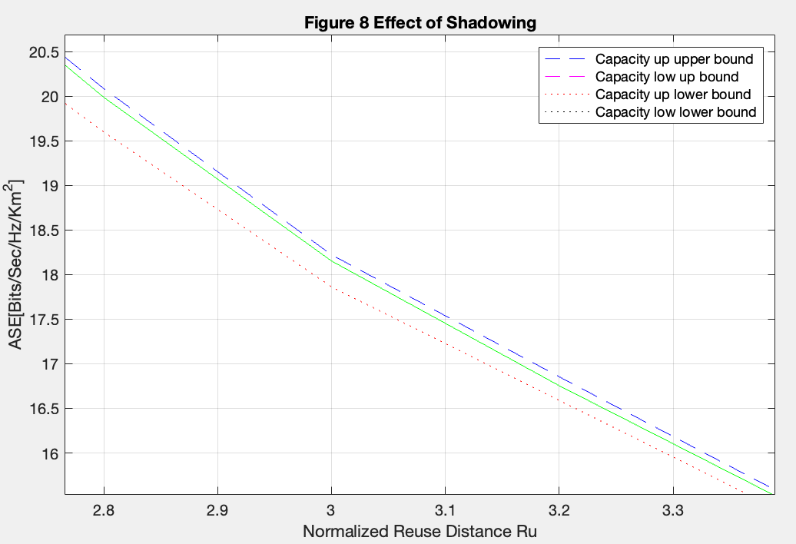
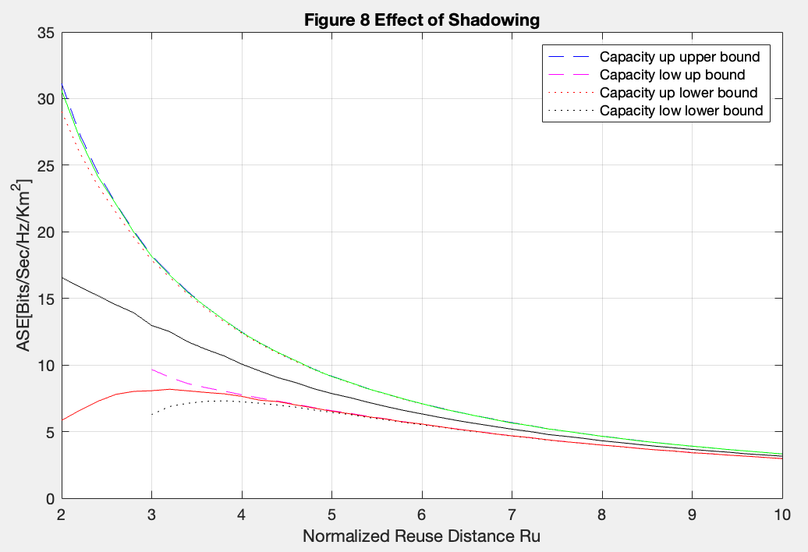
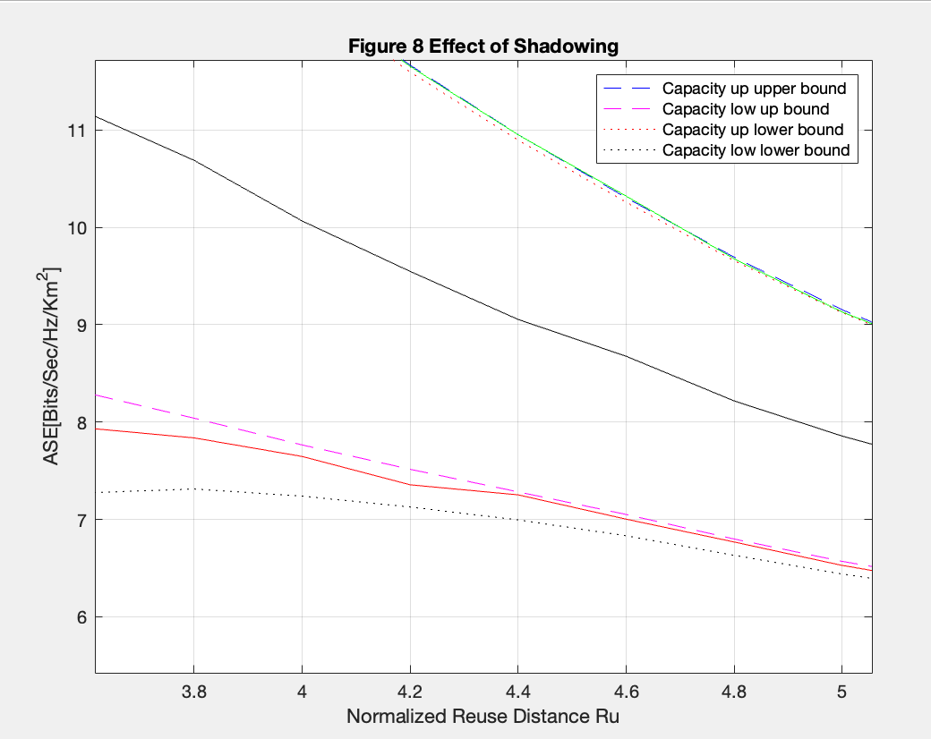
Four main factors affect Area Spectral Efficiency (ASE)
(2) Shadowing

Slide 17
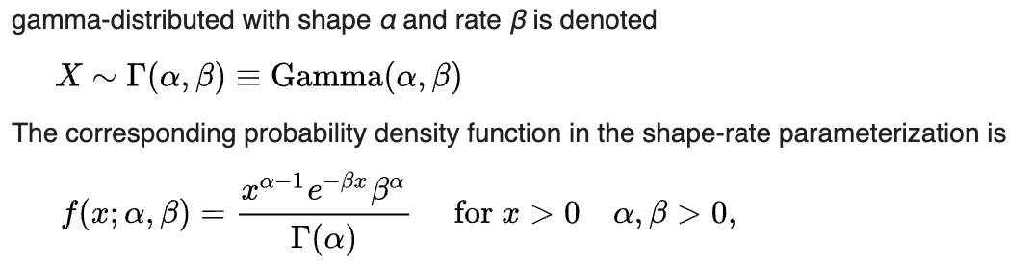
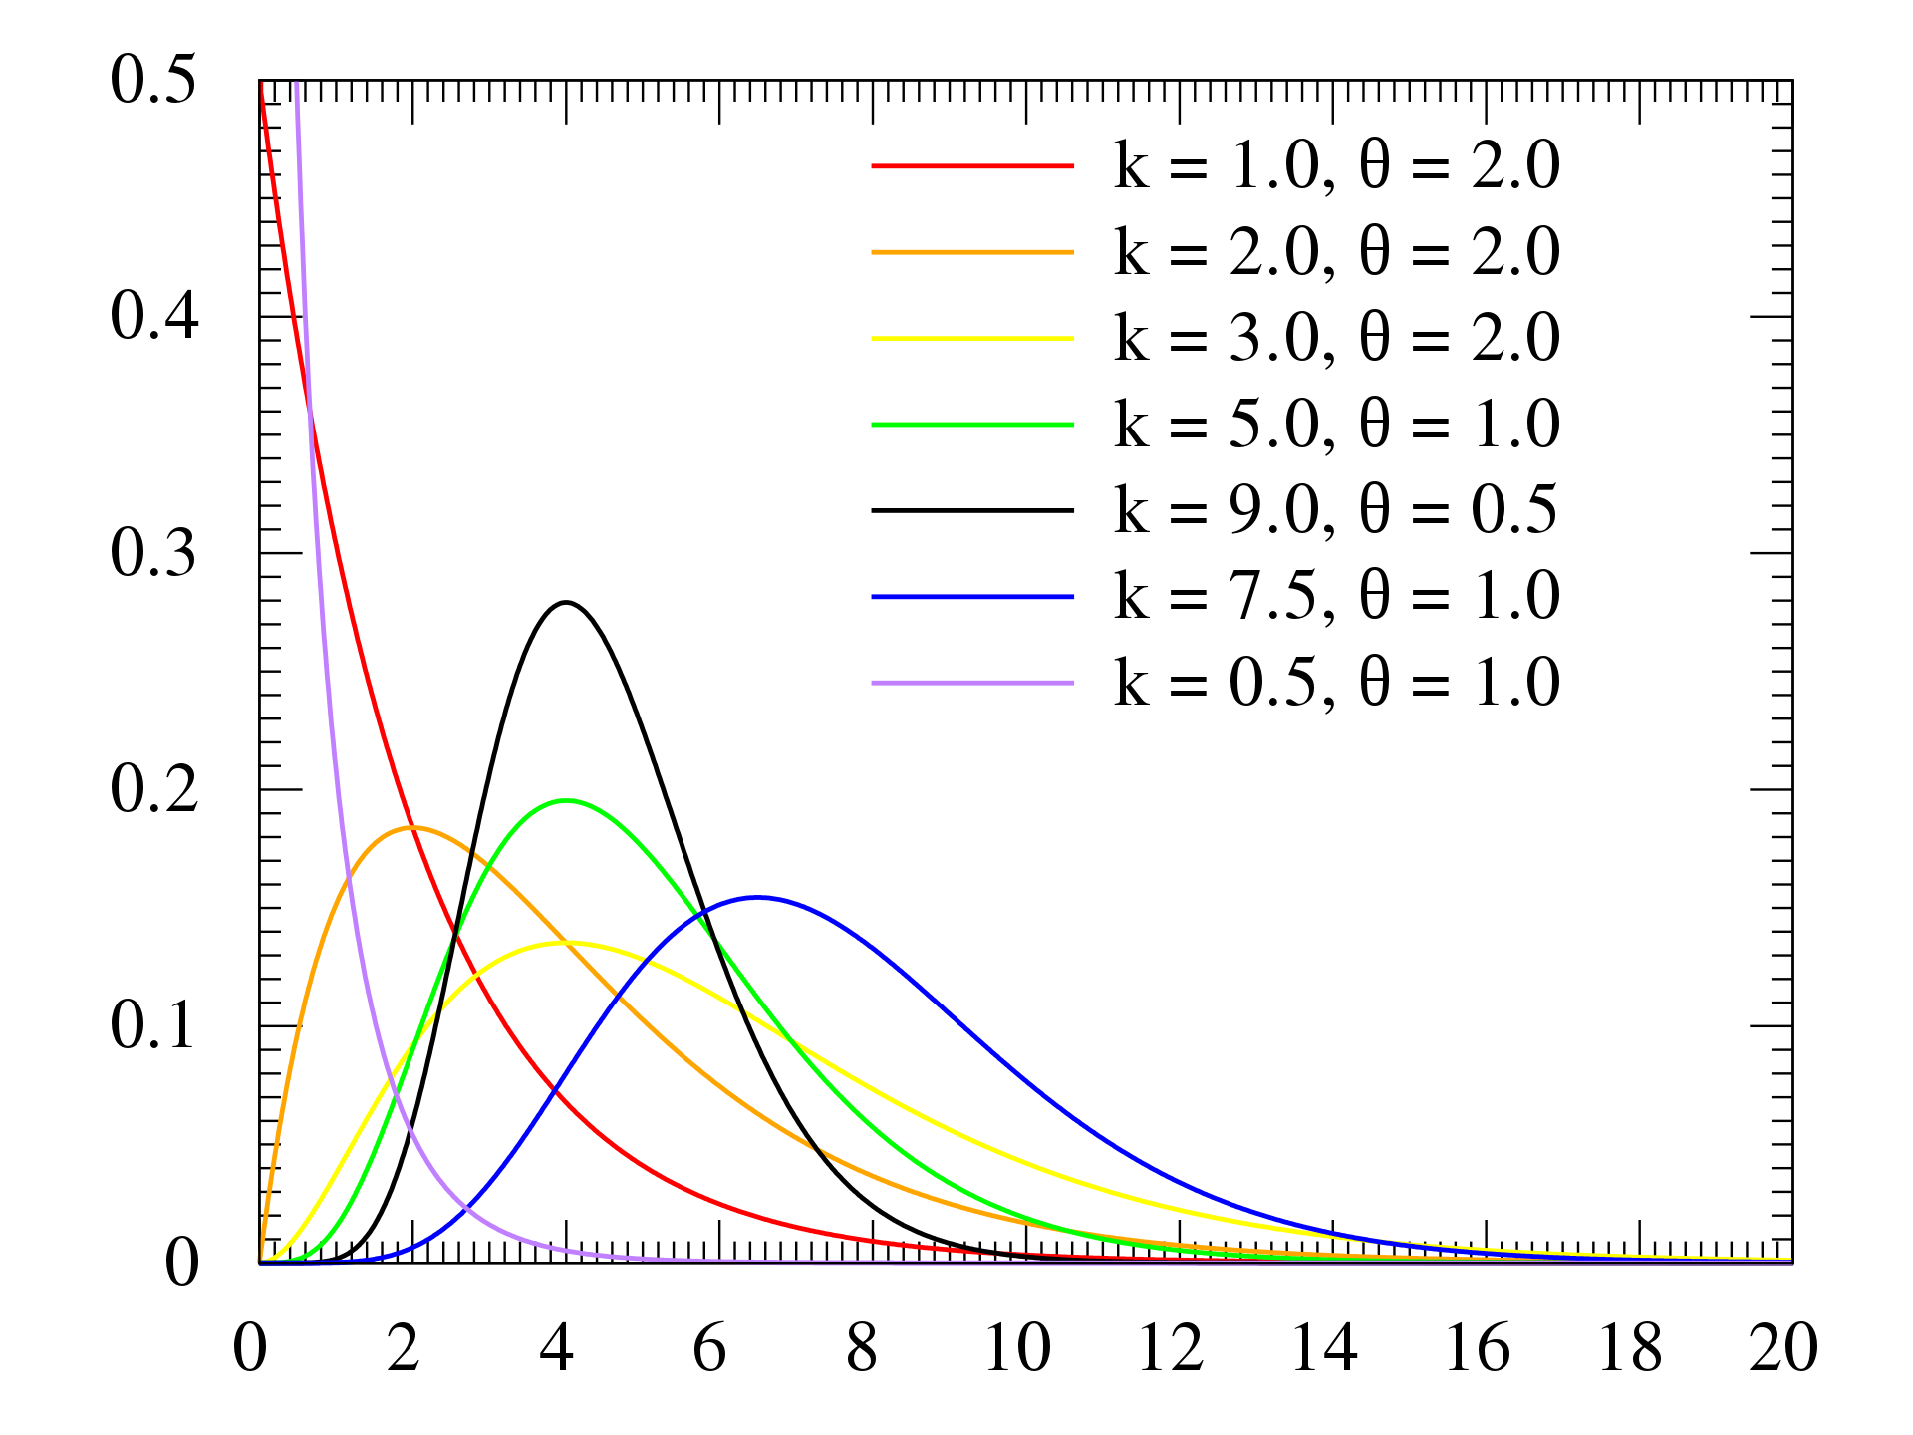
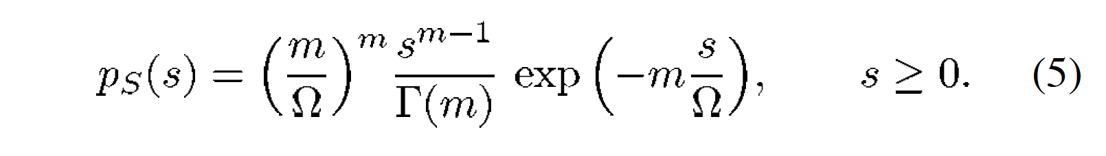
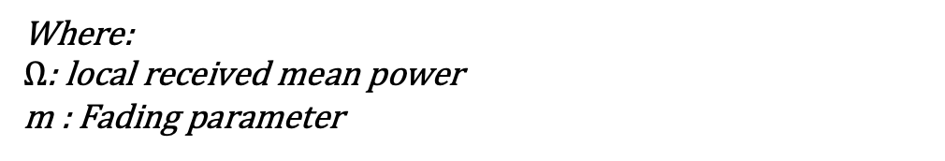
Four main factors affect Area Spectral Efficiency (ASE)
(3) Multipath
Where:
$Ω$: local received mean power
m : Fading parameter

Slide 18
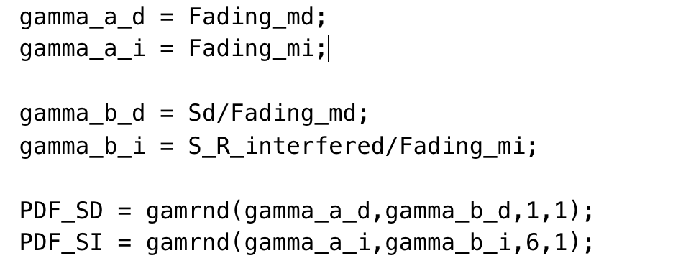
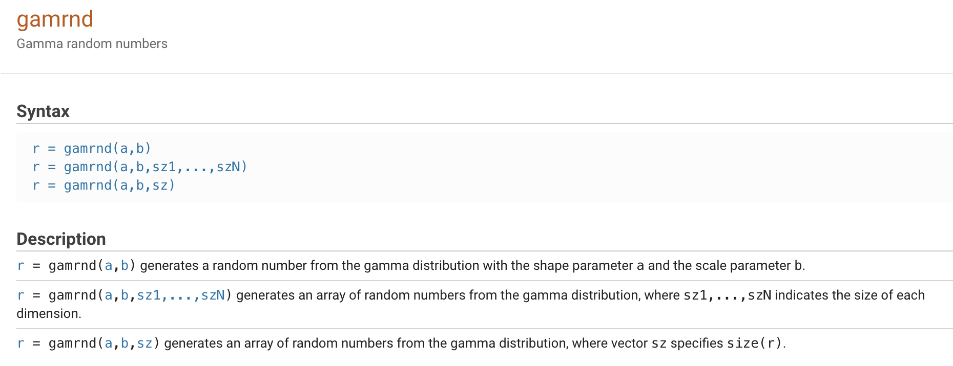
Four main factors affect Area Spectral Efficiency (ASE)
(3) Multipath

Slide 19
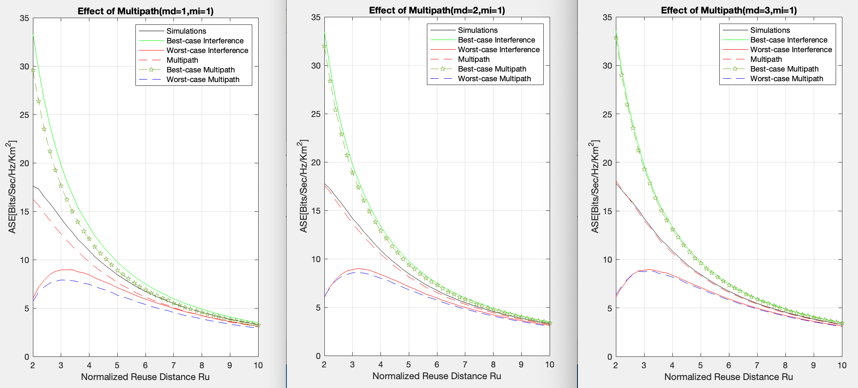
Four main factors affect Area Spectral Efficiency (ASE)
(3) Multipath

Slide 20
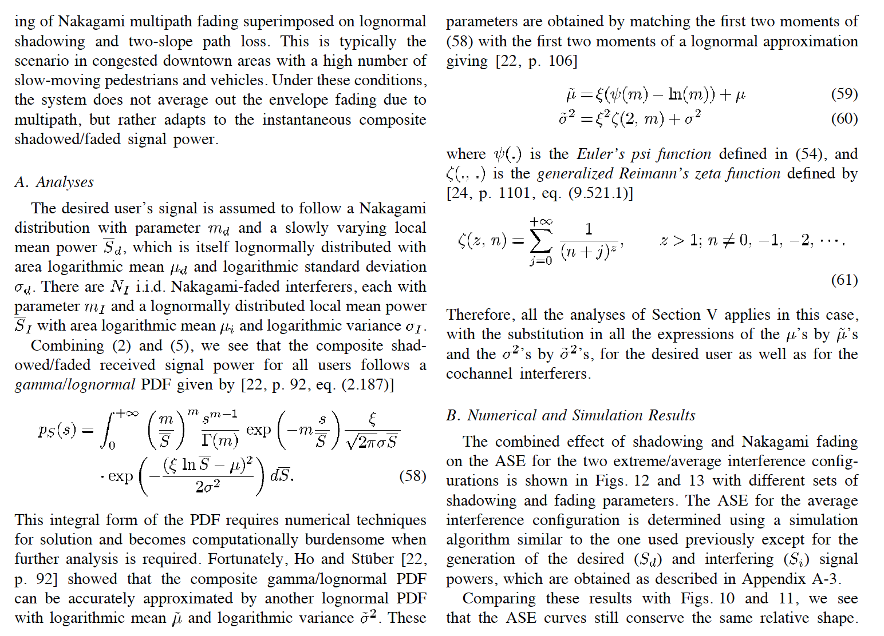
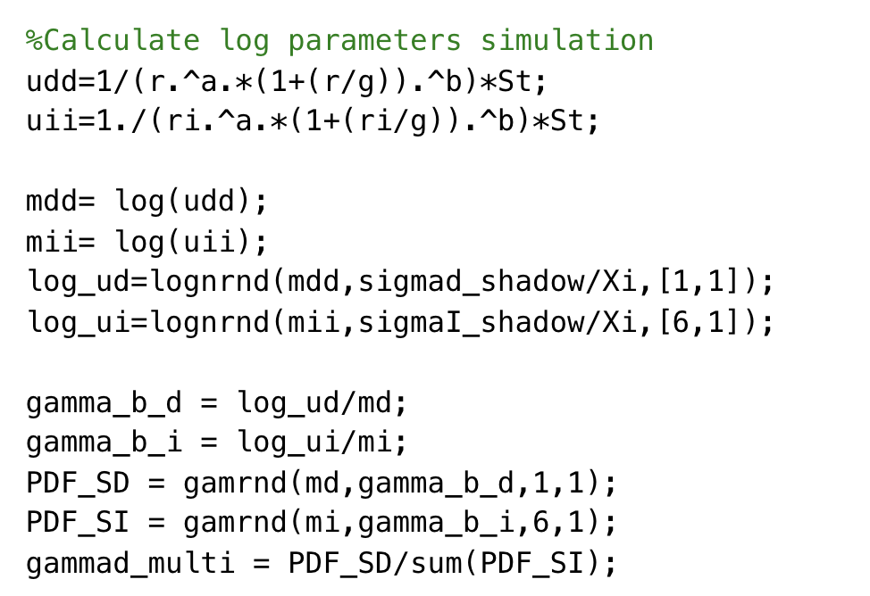
Combination of Path loss, Shadowing, and multipath

Slide 21
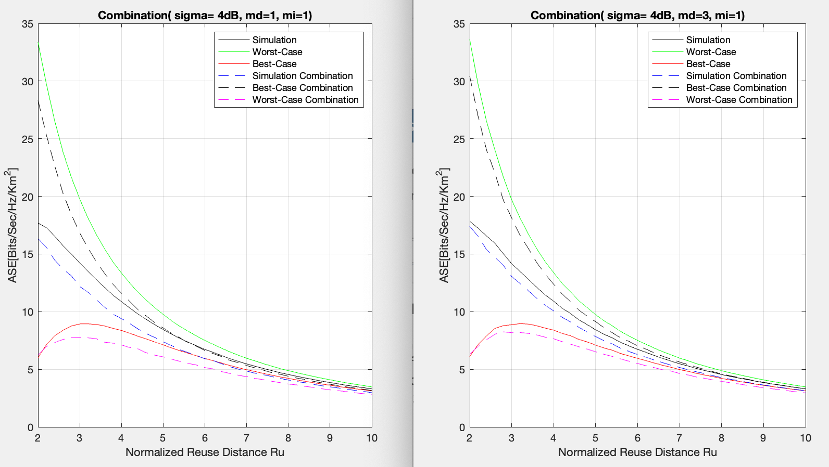
Combination of Path loss, Shadowing, and multipath

Slide 22
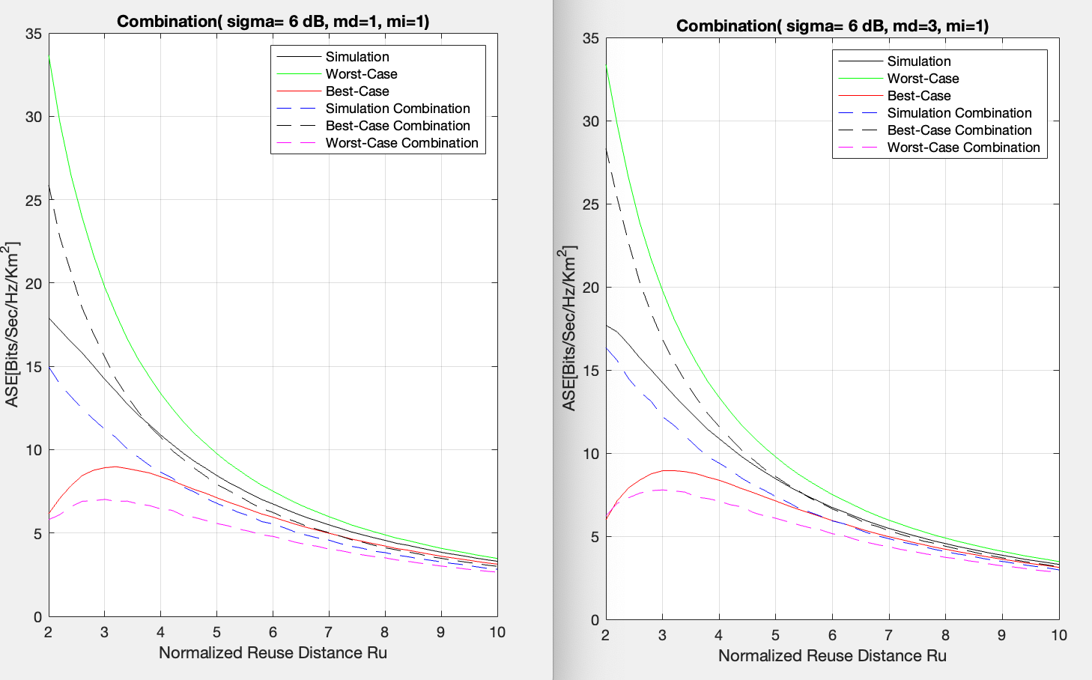
Combination of Path loss, Shadowing, and multipath

Slide 23
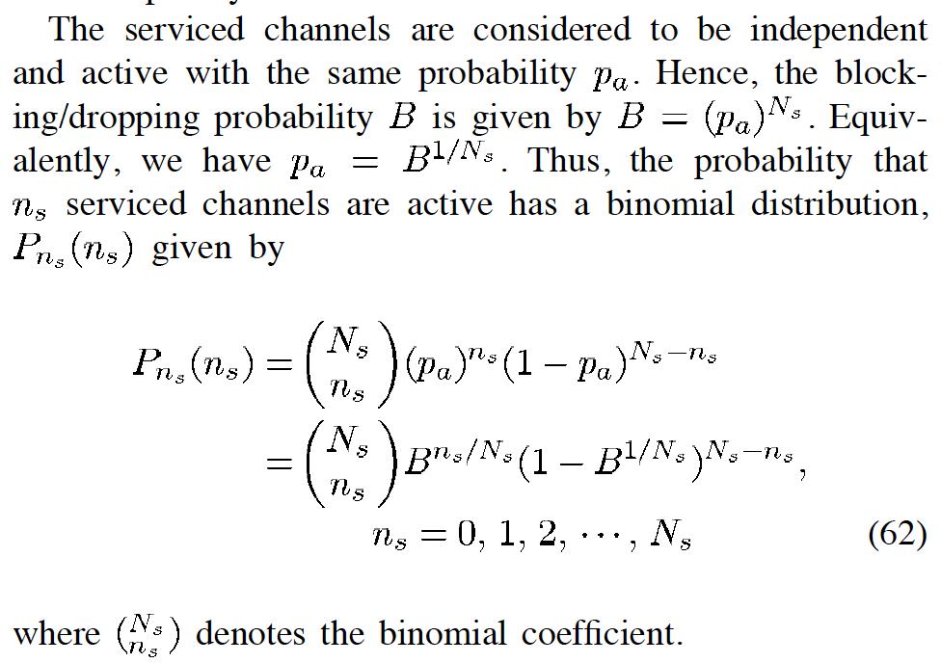
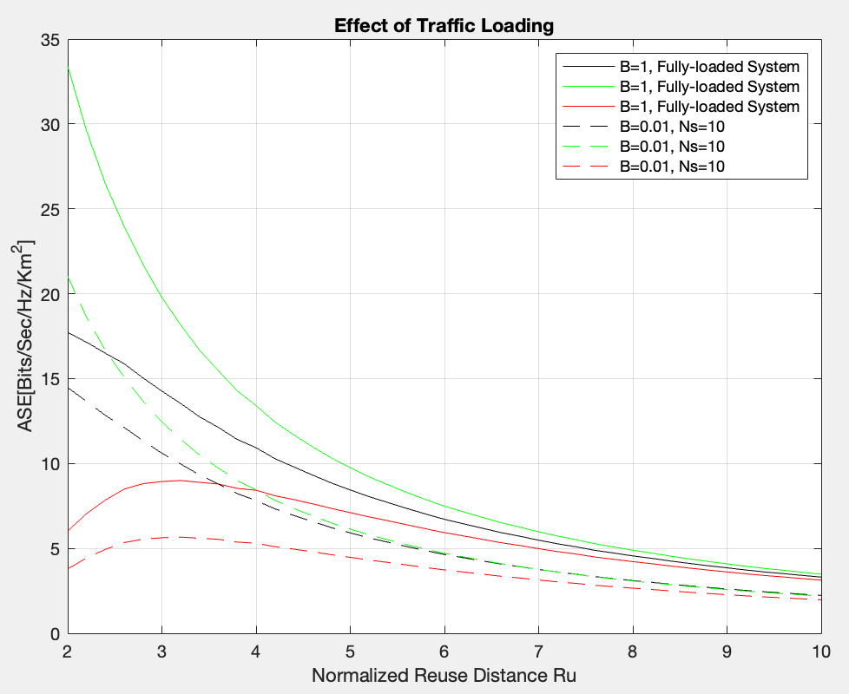
PARTIALLY LOADED SYSTEMS

